Slide 1
Session 5: Correlation & Regression
Lecturer: Dr. Le Hoang Son
Vietnam National University (VNU)
lehoangson@hus.edu.vn
sonlh@vnu.edu.vn

Slide 2
Contents
1
Correlation
2
Regression
3
Multiple Regression
4
Discussion & Exercises

Slide 3
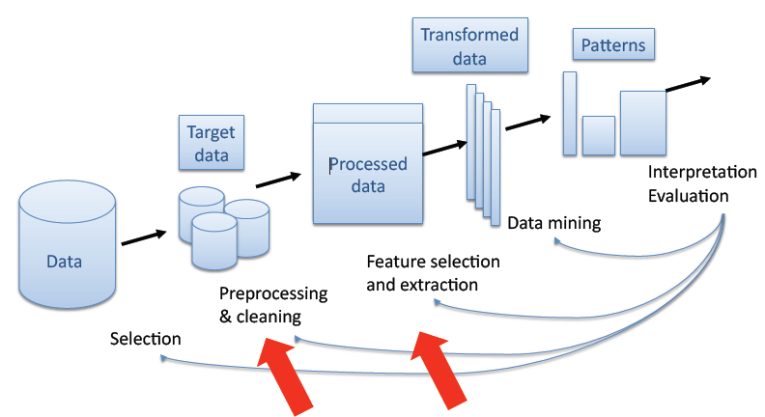
Feature Selection, Dimensionality Reduction, and Clustering in the KDD Process

Slide 4
Common Data Mining tasks
Clustering Classification Regression
X ₂
X ₂
+
+
+
+
+
+
+
+
+
+
+
+
+
-
+
+
+
+
+
-
+
+
+
-
-
+
+
+
+
+
+
+
-
+
+
-
+
k-th Nearest Neighbour
Parzen Window
Unfolding, Conjoint Analysis, Cat-PCA
X ₁
X ₁
X ₁
Linear Discriminant Analysis, QDA
Logistic Regression (Logit)
Decision Trees, LSSVM, NN, VS
Classical Linear Regression
Ridge Regression
NN, CART

Slide 5
1. Correlation
Finding the relationship between two quantitative variables without being able to infer causal relationships
Correlation is a statistical technique used to determine the degree to which two variables are related

Slide 6
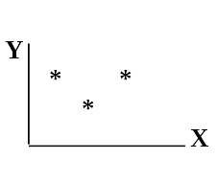
Scatter diagram
Rectangular coordinate
Two quantitative variables
One variable is called independent (X) and the second is called dependent (Y)
Points are not joined
No frequency table

Slide 7
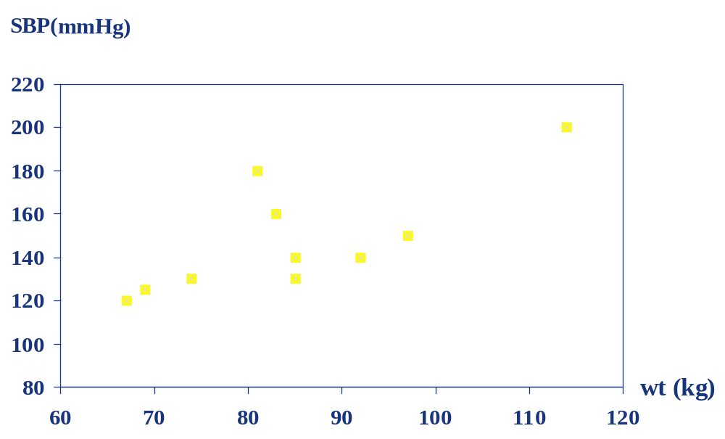
Correlation between SBP vs. WT

Slide 8
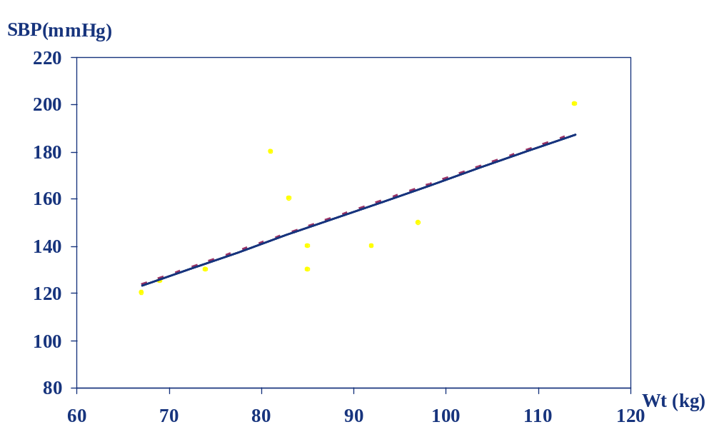
Scatter diagram of weight and systolic blood pressure

Slide 9
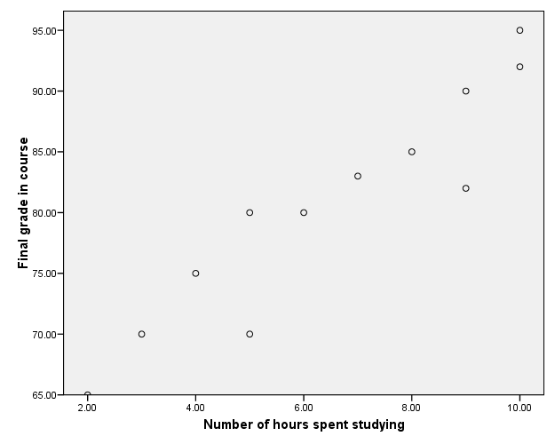
Scatter plots
The pattern of data is indicative of the type of relationship between two variables:
positive relationship negative relationship
Reliability
Age of Car

Slide 10
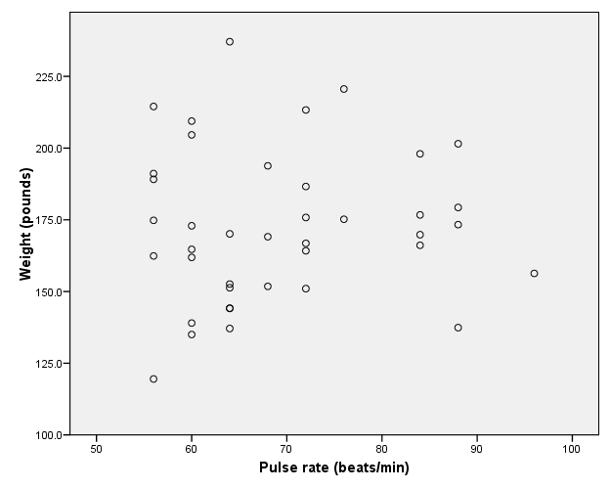
No relation

Slide 11
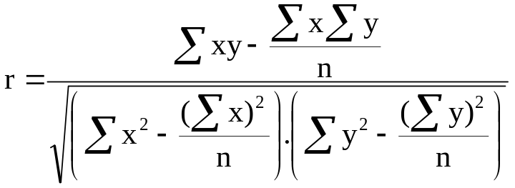
Correlation Coefficient
Statistic showing the degree of relation between two variables. It is also called Pearson's correlation (r) or product moment correlation coefficient.
It measures the nature and strength between two variables of the quantitative type:
  If the sign is +ve this means the relation is direct (an increase in one variable is associated with an increase in the
  other variable and a decrease in one variable is associated with
  decrease in the other variable).
  While if the sign is -ve this means an inverse or indirect relationship (which means an increase in one variable is associated with a decrease in the other).

Slide 12
Correlation Coefficient (2)
The value of r ranges between ( -1) and ( +1)
The value of r denotes the strength of the association as illustrated by the following diagram.
strong
intermediate
weak
weak
intermediate
strong
-1
-0.75
-0.25
0
0.25
0.75
1
indirect
Direct
perfect correlation
perfect correlation
no relation

Slide 13
Example
A sample of 6 children was selected, data about their age in years and weight in kilograms was recorded as shown in the following table . It is required to find the correlation between age and weight.
serial No | Age (years) | Weight (Kg)
1 | 7 | 12
2 | 6 | 8
3 | 8 | 12
4 | 5 | 10
5 | 6 | 11
6 | 9 | 13

Slide 14
Example (2)
Serial n. | Age (years) (x) | Weight (Kg) (y) | xy | X² | Y²
1 | 7 | 12 | 84 | 49 | 144
2 | 6 | 8 | 48 | 36 | 64
3 | 8 | 12 | 96 | 64 | 144
4 | 5 | 10 | 50 | 25 | 100
5 | 6 | 11 | 66 | 36 | 121
6 | 9 | 13 | 117 | 81 | 169
Total | ∑x= 41 | ∑y= 66 | ∑xy= 461 | ∑x2= 291 | ∑y2= 742

Slide 15
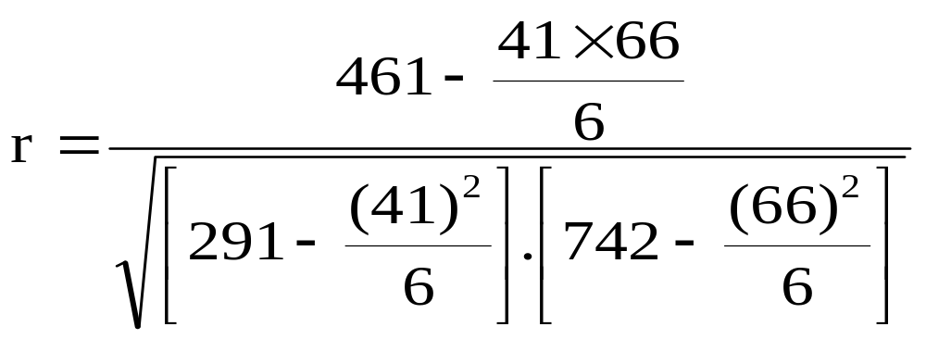
Example (3)
r = 0.759
strong direct correlation

Slide 16
Spearman Rank Correlation Coefficient (r_{s})
It is a non-parametric measure of correlation.
This procedure makes use of the two sets of ranks that may be assigned to the sample values of x and Y.
Spearman Rank correlation coefficient could be computed in the following cases:
  Both variables are quantitative.
  Both variables are qualitative ordinal.
  One variable is quantitative and the other is qualitative ordinal.

Slide 17
Procedure:
Rank the values of X from 1 to n where n is the numbers of pairs of values of X and Y in the sample.
Rank the values of Y from 1 to n.
Compute the value of di for each pair of observation by subtracting the rank of Y_{i} from the rank of X_{i}
Square each d_{i} and compute ∑d_{i}² which is the sum of the squared values.

Slide 18
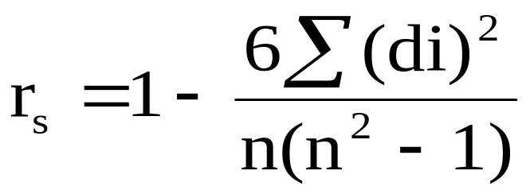
Apply the following formula
The value of r_{s} denotes the magnitude and nature of association giving the same interpretation as simple r.

Slide 19
Example
In a study of the relationship between level education and income the following data was obtained. Find the relationship between them and comment
sample numbers | level education (X) | Income (Y)
A | Preparatory. | 25
B | Primary. | 10
C | University. | 8
D | secondary | 10
E | secondary | 15
F | illiterate | 50
G | University. | 60

Slide 20
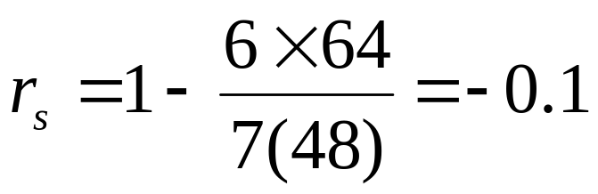
Answer: indirect weak correlation
 | (X) | (Y) | Rank X | Rank Y | di | di²
A | Preparatory | 25 | 5 | 3 | 2 | 4
B | Primary. | 10 | 6 | 5.5 | 0.5 | 0.25
C | University. | 8 | 1.5 | 7 | -5.5 | 30.25
D | secondary | 10 | 3.5 | 5.5 | -2 | 4
E | secondary | 15 | 3.5 | 4 | -0.5 | 0.25
F | illiterate | 50 | 7 | 2 | 5 | 25
G | university. | 60 | 1.5 | 1 | 0.5 | 0.25
∑ di²=64

Slide 21
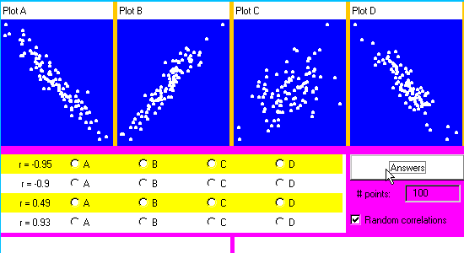
Illustration

Slide 22
Contents
1
Correlation
2
Regression
3
Multiple Regression
4
Discussion & Exercises

Slide 23
2. Regression Analyses
Correlation describes the strength of a linear relationship between two variables (Linear means “straight line”)
Regression tells us how to draw the straight line described by the correlation. It is a technique concerned with predicting some variables by knowing others
The process of predicting variable Y using variable X
Uses a variable (x) to predict some outcome variable (y)
Tells you how values in y change as a function of changes in values of x

Slide 24
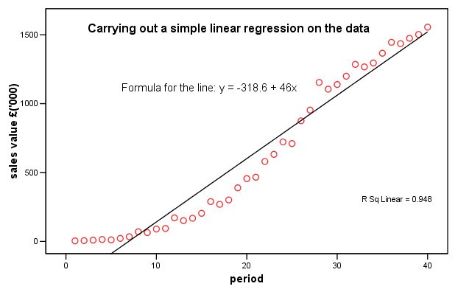
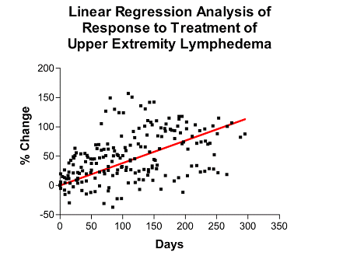
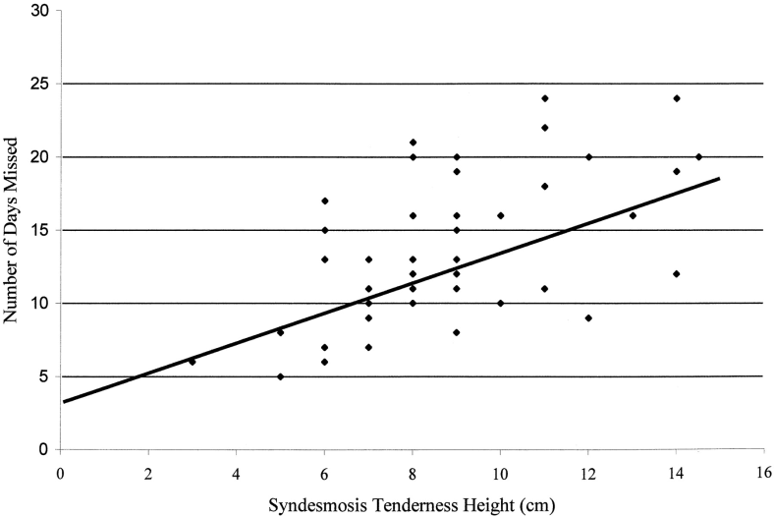
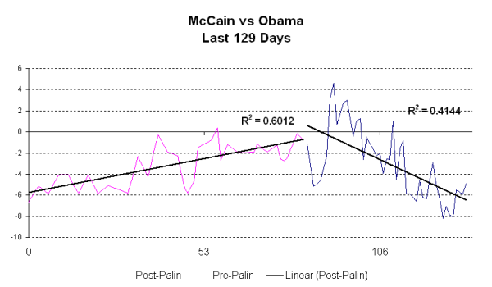
Linear regression analysis examples

Slide 25
The Regression task
Given data on m explanatory variables and 1 explained variable, where the explained variable can take real values in ℜ¹, find a function that gives the “best” fit:
Given: ( x₁, y₁ ), … , ( x_{m} , y_{m} ) ∈ ℜ^{n} X ℜ ¹
Find: ƒ : ℜ^{n} → ℜ ¹
“best function” = the expected error on unseen data ( x_{m+1}, y_{m+1} ), … , ( x_{m+k} , y_{m+k} ) is minimal

Slide 26
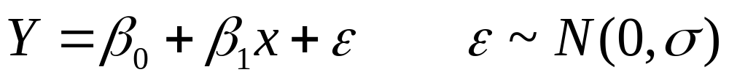
Classical Linear Regression (OLS)
Explanatory and Response Variables are Numeric
Relationship between the mean of the response variable and the level of the explanatory variable assumed to be approximately linear (straight line)
Model:
β₁ > 0 ⇒ Positive Association
β₁ < 0 ⇒ Negative Association
β₁ = 0 ⇒ No Association

Slide 27
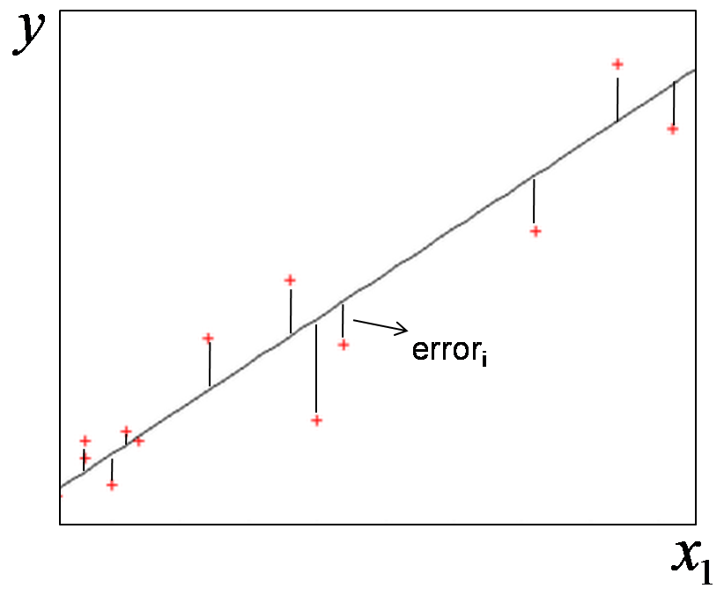
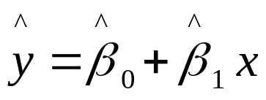
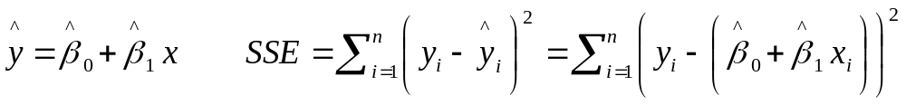
Classical Linear Regression (OLS)
β₀ ≡ Mean response when x=0 (y-intercept)
β₁ ≡ Change in mean response when x increases by 1 unit (slope)
β₀, β₁ are unknown parameters (like μ)
β₀+β₁x ≡ Mean response when explanatory variable takes on the value x
Task:
Minimize the sum of squared errors:

Slide 28
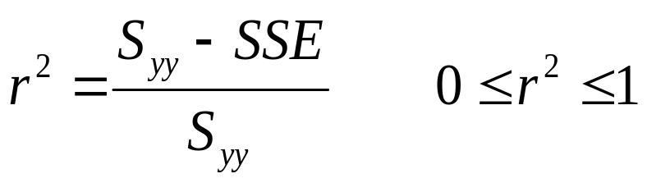
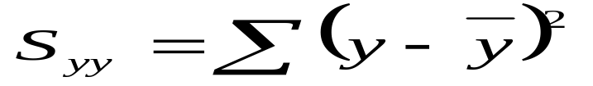
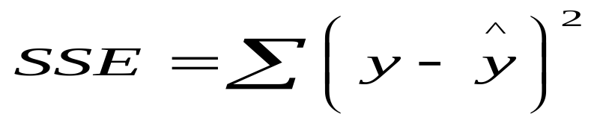
Classical Linear Regression (OLS)
Coefficient of determination (r²) : proportion of variation in y “explained” by the regression on x.
where

Slide 29
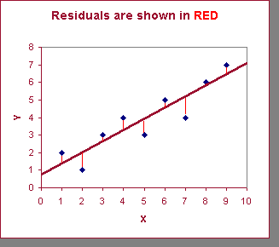
Least Squares Regression
GOAL - minimize the sum of the square of the errors of the data points
Minimize Mean Square Error (MSE)
Notes:
Regression analysis tries to fit a model to one response variable based on one or more explanatory variables. In most cases, there will be error. See the graph below for an example of Simple Linear Regression.
The actual data points (x,y) are the blue dots
The Least Squares linear model (regression line) of the response (y) variable based on the the explanatory (x) variable is shown in black.
The errors (residuals) for each data point to its predicted value are the vertical lines shown in red.
The goal, in general, is to minimize the errors from the actual data to the regression line. The least squares line minimizes the sum of the square of the errors.

Slide 30
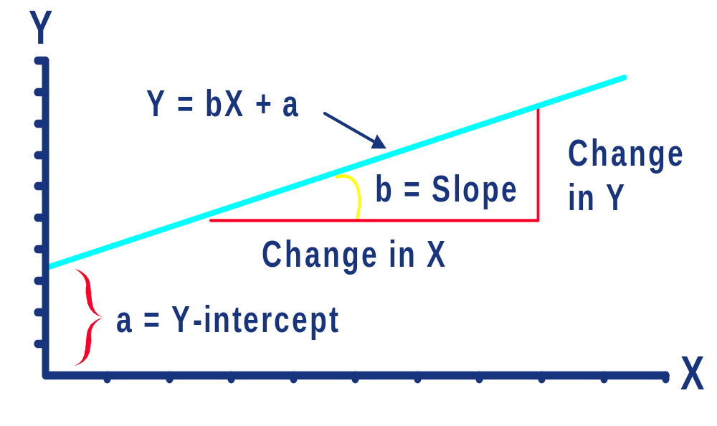
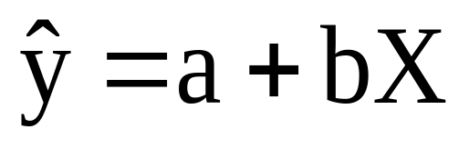
Linear Equation
Regression equation describes the regression line mathematically
Notes:
28

Slide 31



Simple Linear Regression Model (Important)

Slide 32
Example: Hours studying and grades

Slide 33
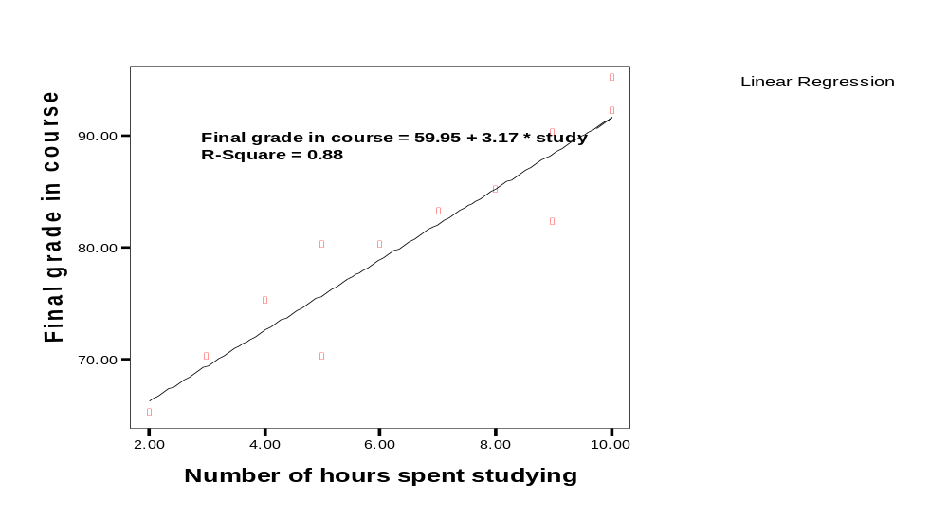
Regressing grades on hours
Predicted final grade in class =
59.95 + 3.17*(number of hours you study per week)

Slide 34
Predicted final grade in class = 59.95 + 3.17*(hours of study)
Predict the final grade of…:
Someone who studies for 12 hours
Final grade = 59.95 + (3.17*12)
= 97.99
Someone who studies for 1 hour:
Final grade = 59.95 + (3.17*1)
= 63.12

Slide 35
Exercise
A sample of 6 persons was selected the value of their age ( x variable) and their weight is demonstrated in the following table. Find the regression equation and what is the predicted weight when age is 8.5 years.
Serial no. | Age (x) | Weight (y)
1 2 3 4 5 6 | 7 6 8 5 6 9 | 12 8 12 10 11 13

Slide 36
Answer
Serial no. | Age (x) | Weight (y) | xy | X² | Y²
1 2 3 4 5 6 | 7 6 8 5 6 9 | 12 8 12 10 11 13 | 84 48 96 50 66 117 | 49 36 64 25 36 81 | 144 64 144 100 121 169
Total | 41 | 66 | 461 | 291 | 742

Slide 37
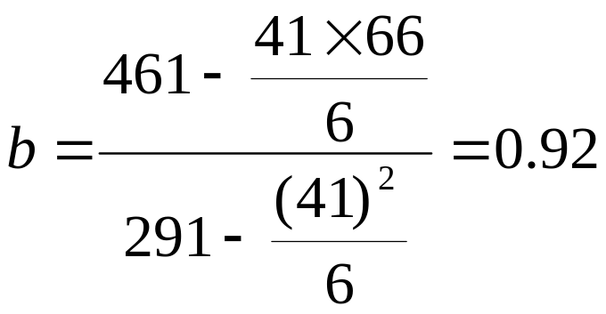
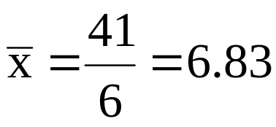
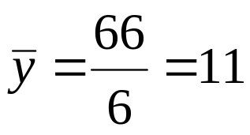
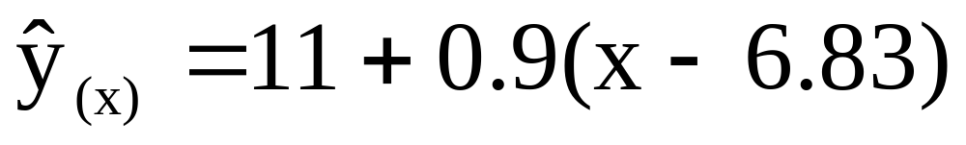
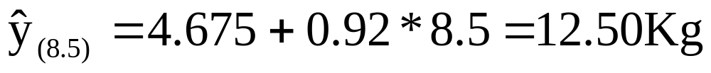
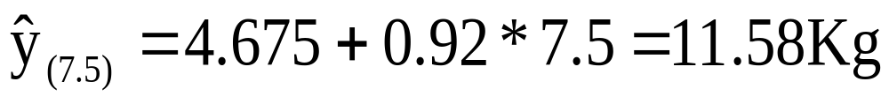
Answer (2)
Regression equation

Slide 38
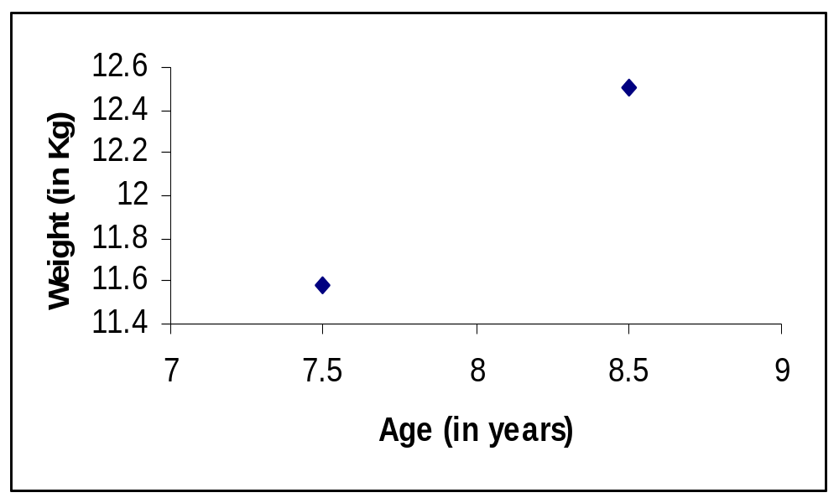
Answer (3)

Slide 39
Exercise 2
Age (x) | B.P (y) | Age (x) | B.P (y)
20 43 63 26 53 31 58 46 58 70 | 120 128 141 126 134 128 136 132 140 144 | 46 53 60 20 63 43 26 19 31 23 | 128 136 146 124 143 130 124 121 126 123
The following are the age (in years) and systolic blood pressure of 20 apparently healthy adults
Find the correlation between age and blood pressure (BP) using simple and Spearman's correlation coefficients, and comment.
Find the regression equation?
What is the predicted blood pressure for a man aging 25 years?

Slide 40
Exercise 2
Serial | x | y | xy | x²
1 | 20 | 120 | 2400 | 400
2 | 43 | 128 | 5504 | 1849
3 | 63 | 141 | 8883 | 3969
4 | 26 | 126 | 3276 | 676
5 | 53 | 134 | 7102 | 2809
6 | 31 | 128 | 3968 | 961
7 | 58 | 136 | 7888 | 3364
8 | 46 | 132 | 6072 | 2116
9 | 58 | 140 | 8120 | 3364
10 | 70 | 144 | 10080 | 4900

Slide 41
Exercise 2
Serial | x | y | xy | x²
11 | 46 | 128 | 5888 | 2116
12 | 53 | 136 | 7208 | 2809
13 | 60 | 146 | 8760 | 3600
14 | 20 | 124 | 2480 | 400
15 | 63 | 143 | 9009 | 3969
16 | 43 | 130 | 5590 | 1849
17 | 26 | 124 | 3224 | 676
18 | 19 | 121 | 2299 | 361
19 | 31 | 126 | 3906 | 961
20 | 23 | 123 | 2829 | 529
Total | 852 | 2630 | 114486 | 41678

Slide 42
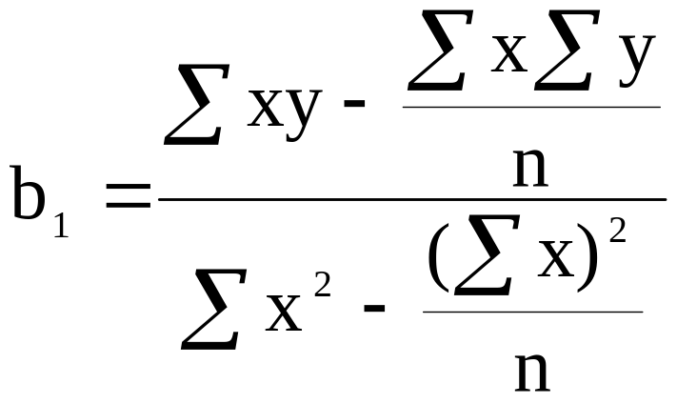
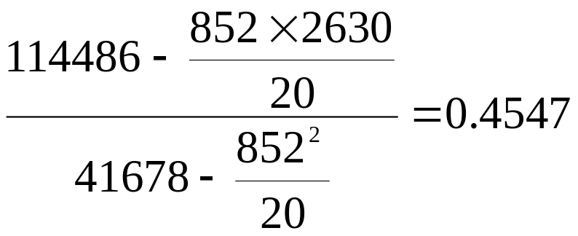
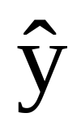
Exercise 2
=
= 112.13 + 0.4547 x
for age 25:
B.P = 112.13 + 0.4547 * 25 = 123.49 = 123.5 mm hg

Slide 43
Contents
1
Correlation
2
Regression
3
Multiple Regression
4
Discussion & Exercises

Slide 44
3. Multiple Regression
Multiple regression analysis is a straightforward extension of simple regression analysis which allows more than one independent variable.
  Numeric Response variable (y)
  p: Numeric predictor variables
  Model:
  Y = β₀ + β₁x₁ + ⋅⋅⋅ + β_{p}x_{p} + ε
Partial Regression Coefficients: β_{i} ≡ effect (on the mean response) of increasing the i^{th} predictor variable by 1 unit, holding all other predictors constant

Slide 45
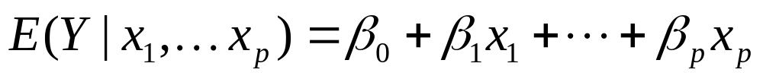
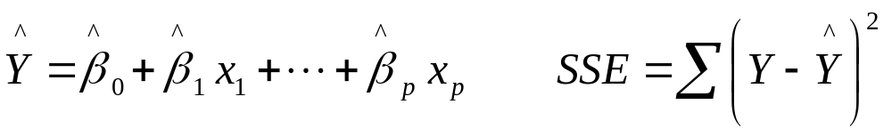
Ordinary Least Squares estimation
Population Model for mean response:
Least Squares Fitted (predicted) equation, minimizing SSE:

Slide 46
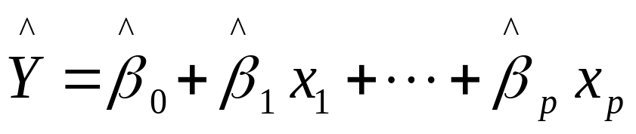
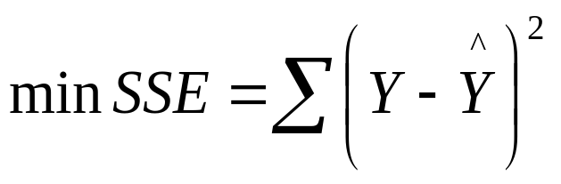
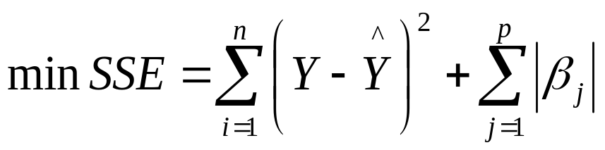
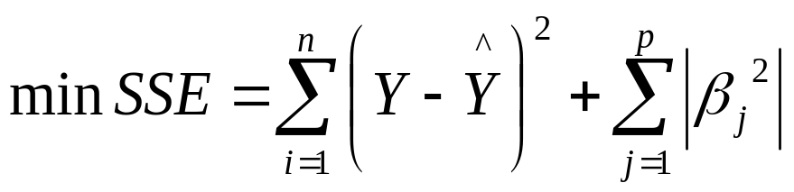
Ordinary Least Squares estimation (2)
Model:
OLS estimation:
LASSO estimation:
Ridge regression estimation:

Slide 47
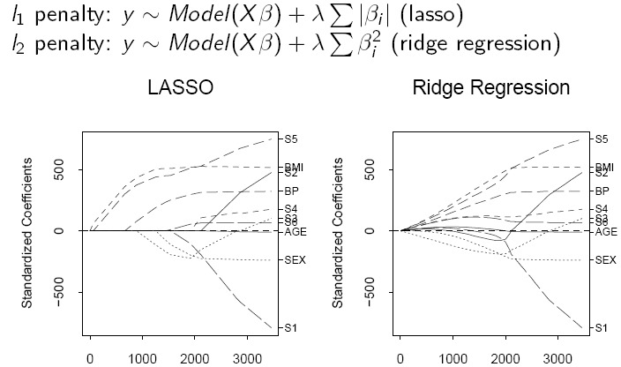
LASSO and Ridge estimation of model coefficients
sum(|beta|)
sum(|beta|)

Slide 48
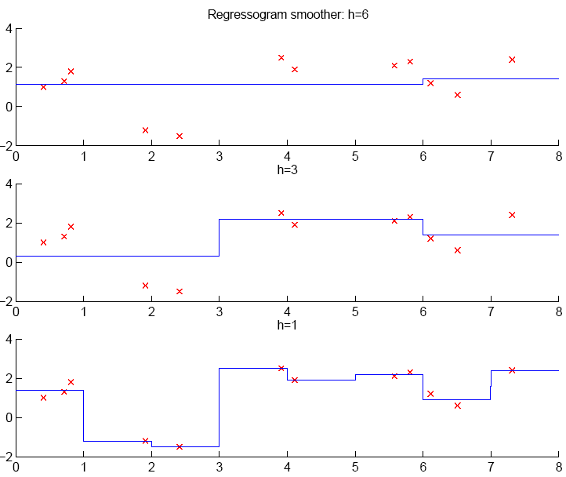
Nonparametric (local) regression estimation: K-NN, Decision trees, smoothers

Slide 49
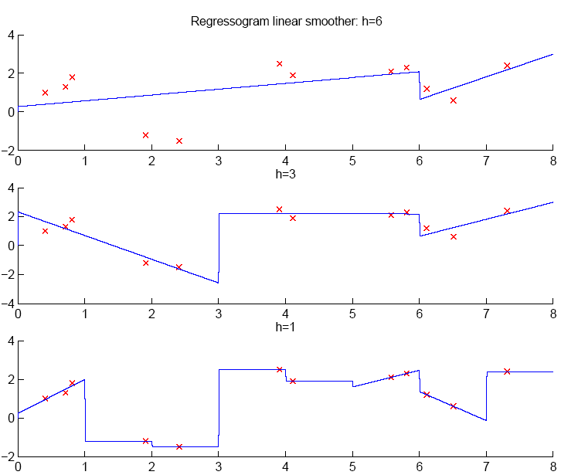
Nonparametric (local) regression estimation: K-NN, Decision trees, smoothers

Slide 50
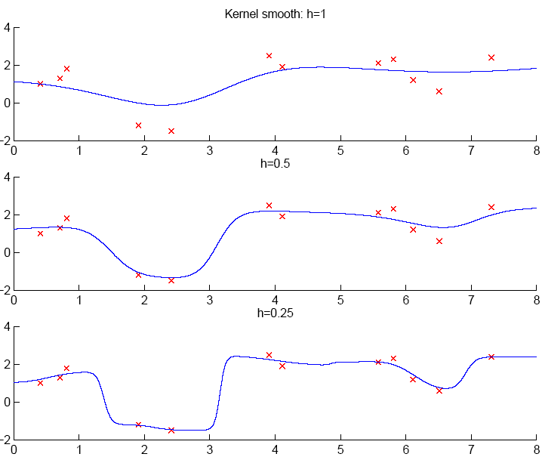
Nonparametric (local) regression estimation: K-NN, Decision trees, smoothers

Slide 51
Nonparametric (local) regression estimation: K-NN, Decision trees, smoothers
When k or h is small, single instances matter; bias is small, variance is large (undersmoothing): High complexity
As k or h increases, we average over more instances and variance decreases but bias increases (oversmoothing): Low complexity
Cross-validation is used to finetune k or h.

Slide 52

Linear Support Vector Regression
small area
middle-sized area
biggest area
●
●
●
●
●
●
●
●
●
Expenditures
●
Expenditures
●
Expenditures
●
●
●
●
●
●
●
●
●
●
“Support vectors”
Age
Age
Age
“Lazy case”
(underfitting)
“Suspiciously smart case”
(overfitting)
“Compromise case”, SVR
(good generalisation)
The thinner the “tube”, the more complex the model

Slide 53
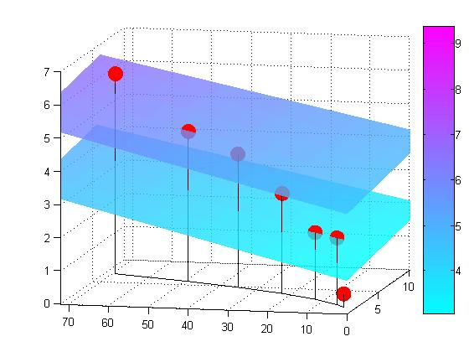
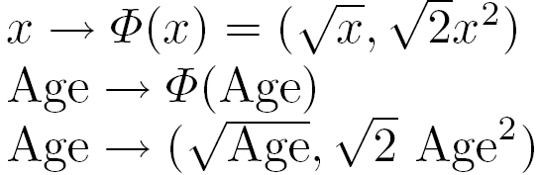





Non-Linear Support Vector Regression
Map the data into a higher-dimensional space:
●
●
●
Expenditures
●
●
●
●
Age

Slide 54

Non-Linear Support Vector Regression
Map the data into a higher-dimensional space:
●
●
●
Expenditures
●
●
●
●
Age

Slide 55
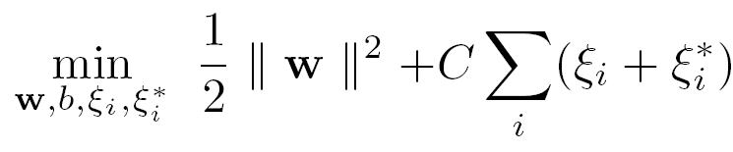
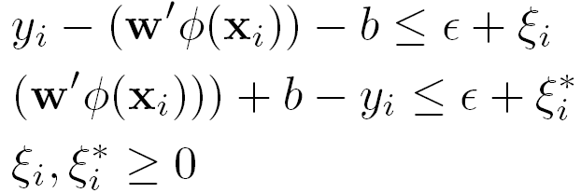


Non-Linear Support Vector Regression
The SVR function:
To find the unknown parameters of the SVR function, solve:
Subject to:
How to choose , ,
  = RBF kernel:
  Find , , , and from a cross-validation procedure

Slide 56


SVR Model Selection
Do 5-fold cross-validation to find and for several fixed values of .

Slide 57



SVR Study: Model Training, Selection and Prediction
CVMSE (IR*, HR*, CR*)
True returns (red) and raw predictions (blue)
CVMSE (IR*, HR*, CR*)

Slide 58




SVR Individual Effects

Slide 59


SVR Technicalities: SVR vs. OLS
Performance on the test set
Performance on the test set
SVR
MSE= 0.04
OLS
MSE= 0.23

Slide 60
Number of training errors vs. Model complexity
Min. number of training errors,
test errors
Model complexity
training errors
complexity
Best trade-off
Functions ordered in increasing complexity

Slide 61

Variable selection for regression
Akaike Information Criterion (AIC). Final prediction error:

Slide 62

Variable selection for regression
Bayesian Information Criterion (BIC), also known as Schwarz criterion. Final prediction error:
BIC tends to choose simpler models than AIC.

Slide 63

Variable selection for regression
R^2-adjusted:

Slide 64

Questions

Slide 65
Contents
1
Correlation
2
Regression
3
Multiple Regression
4
Discussion & Exercises

Slide 66
Exercises
See PDF file.

Slide 67

Main reference (and other slides..)

Slide 68
Thank You !
Click to edit company slogan .

